Slide 1

What Is The Best VPN Monthly Deal?

Slide 2
VPN Olympics  : Background
In a quest to find the Best VPN  Monthly Deal among the best VPN  services available now, we compared the offers from 19 different VPN  best providers and tried to understand what are the best VPN monthly deals for their various offers, for which the most popular ones are monthly VPN subscription, 12 months / annual VPN subscription, and 3 years / 36 months subscription.
But other options offered by several VPN services are 3 months subscription, 6 months subscription, 18 months subscription or even 2 years subscription.
Therefore, on top of including a check for the best deal for all these categories, we also included an average VPN  monthly deal price for all of them in the competition, which also helped to rank them among each other even when they did not win any best VPN monthly deal medal in any category.
When a provider didn't offer the exact subscription, we took in consideration the price offered for the closest subscription - and when they had no offer at all for a monthly deal, we had to count it as a $99 deal to take them off the competition, as then cannot even compete with other VPNs that are offering this service.
Offers taken in consideration are the standard ones, punctual deals and special discounts are discarded.
We checked the VPN  with the most wins, and compared them like Olympics would, thus creating this Best VPN monthly deal Olympics comparison, and results are right below.

Slide 3


VPN Olympics  : What Is The Best VPN Monthly Deal?

$2.39
(3 years)

$3.5
(1 year)
1

$6.49
(6 months)
2
3

Slide 4












VPN Olympics  : What Is The Best VPN Monthly Deal?
 | NordVPN | CyberGhost VPN | Express VPN | SurfShark VPN | PureVPN | Ivacy VPN | OVPN | VPN Proxy Master | VyprVPN | RUS VPN | BullGuard VPN | Avira Phantom VPN Pro | Proton VPN | Hide.me | Betternet | SaferVPN | Tunnel Bear | Avast SecureLine VPN | AVG Secure VPN
1 month | $11.95 | $12.99 | $12.95 | $12.95 | $10.95 | $9.95 | $11.00 | $11.99 | $99.00 | $7.99 | $11.99 | $10.00 | $10.00 | $12.95 | $12.99 | $12.95 | $9.99 | $99.00 | $99.00
3 months | $11.95 | $12.99 | $12.95 | $12.95 | $10.95 | $9.95 | $11.00 | $11.99 | $12.95 | $7.99 | $11.99 | $10.00 | $10.00 | $12.95 | $12.99 | $12.95 | $9.99 | $99.00 | $99.00
6 months | $11.95 | $12.99 | $9.99 | $6.49 | $10.95 | $9.95 | $6.99 | $11.99 | $12.95 | $7.99 | $11.99 | $10.00 | $10.00 | $12.95 | $12.99 | $12.95 | $9.99 | $99.00 | $99.00
12 months / 1 year | $4.91 | $3.99 | $8.32 | $6.49 | $10.95 | $3.50 | $4.99 | $5.83 | $12.95 | $3.99 | $6.94 | $6.50 | $8.00 | $8.32 | $7.99 | $5.49 | $4.99 | $4.99 | $4.99
18 months | $4.91 | $3.99 | $8.32 | $6.49 | $10.95 | $3.50 | $4.99 | $5.83 | $3.75 | $3.99 | $6.94 | $6.50 | $8.00 | $8.32 | $7.99 | $5.49 | $4.99 | $4.99 | $4.99
24 months / 2 years | $4.91 | $3.49 | $8.32 | $2.49 | $3.33 | $3.50 | $4.99 | $3.75 | $3.75 | $3.99 | $3.96 | $6.50 | $6.63 | $4.99 | $7.99 | $3.29 | $3.33 | $3.99 | $3.99
36 months / 3 years | $4.91 | $2.25 | $8.32 | $2.49 | $3.33 | $3.50 | $4.99 | $3.75 | $2.50 | $2.39 | $2.97 | $6.50 | $6.63 | $4.99 | $7.99 | $2.50 | $3.33 | $3.99 | $3.99
Average monthly $ | $7.93 | $7.53 | $9.88 | $7.19 | $8.77 | $6.26 | $6.99 | $7.88 | $21.12 | $5.48 | $8.11 | $8.00 | $8.47 | $9.35 | $10.13 | $7.95 | $6.66 | $44.99 | $44.99
 | 1 | 1 |  | 1 | 1 |  |  |  |  | 2 |  |  |  |  |  |  | 3
 |  | 1 |  |  |  | 3 | 1 |  | 1 | 2 |  |  |  |  |  | 1
 |  | 1 |  | 2 |  | 2 |  |  |  | 3
1
Buying country: United States Of America
Buying currency: US$
2
3

Slide 5
Winning VPN: RUSVPN

$2.39
RUS VPN  costs on average $5.48 per month
RUS VPN  1 month deal is the cheapest available: only $7.99
RUS VPN  1 year subscription costs as little as $3.99 per month
Getting the best option available, RUS VPN 3 years subscription , you will save as much as 71% compared to other VPN options that are offering similar service!
Is RUS VPN  slowing down connections? No! It can even speed them up 

Slide 6
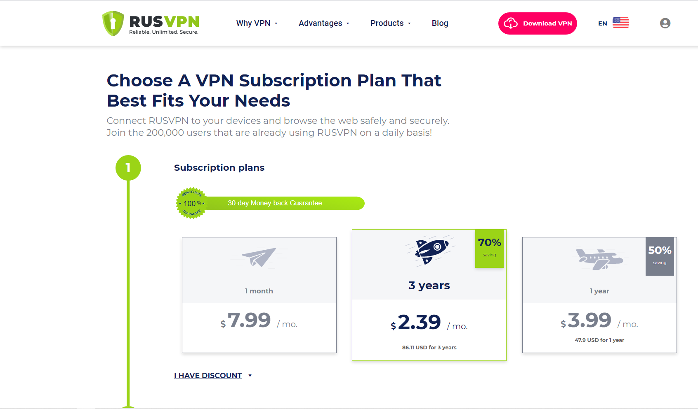
RUSVPN pricing

Slide 7
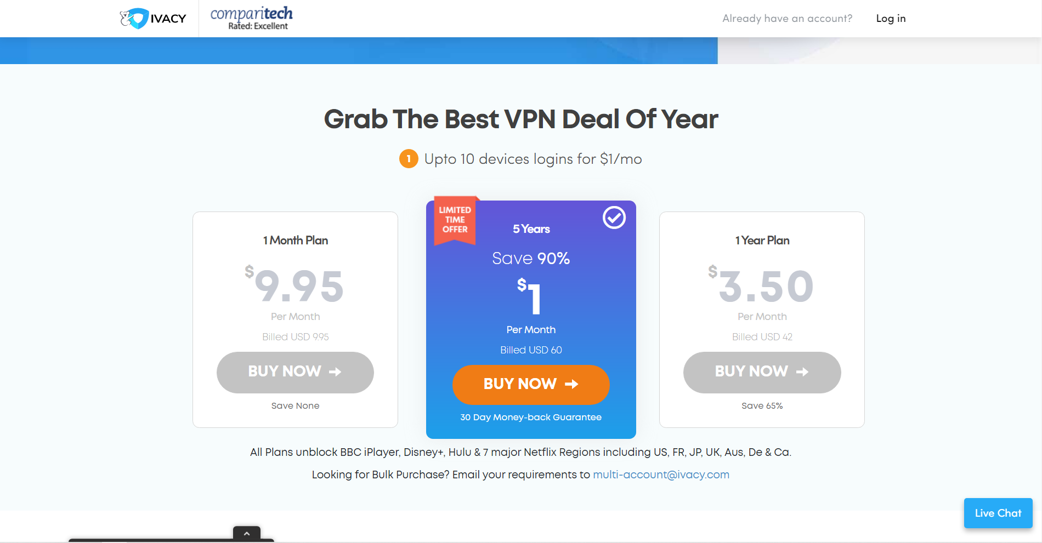
Ivacy VPN pricing

Slide 8
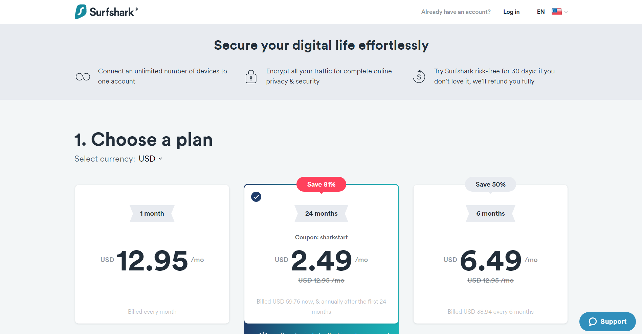
SurfShark VPN pricing

Slide 9
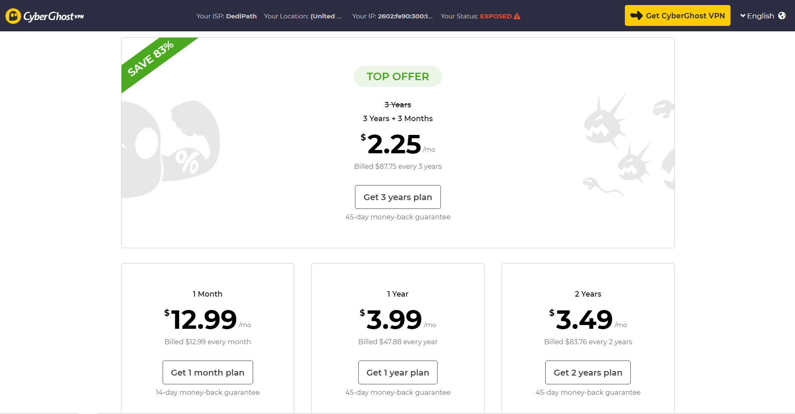
CyberGhost VPN pricing

Slide 10
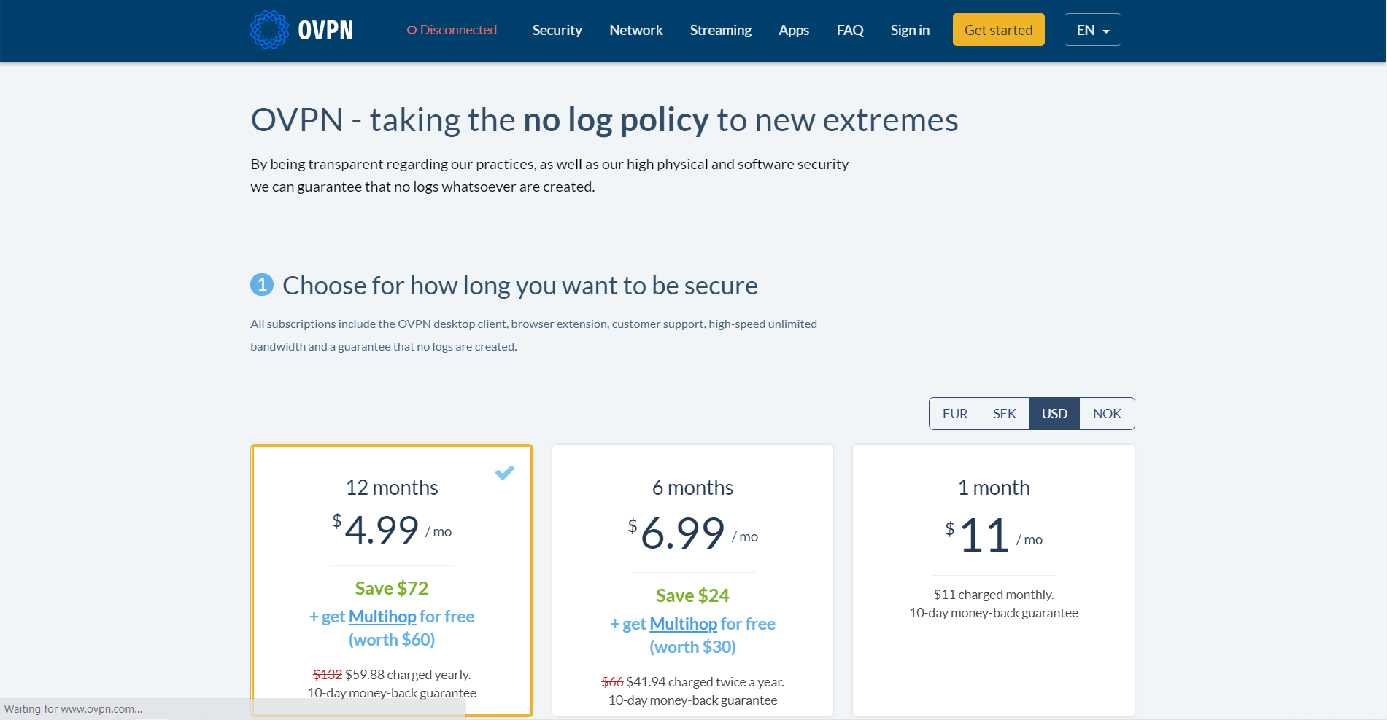
OVPN pricing

Slide 11
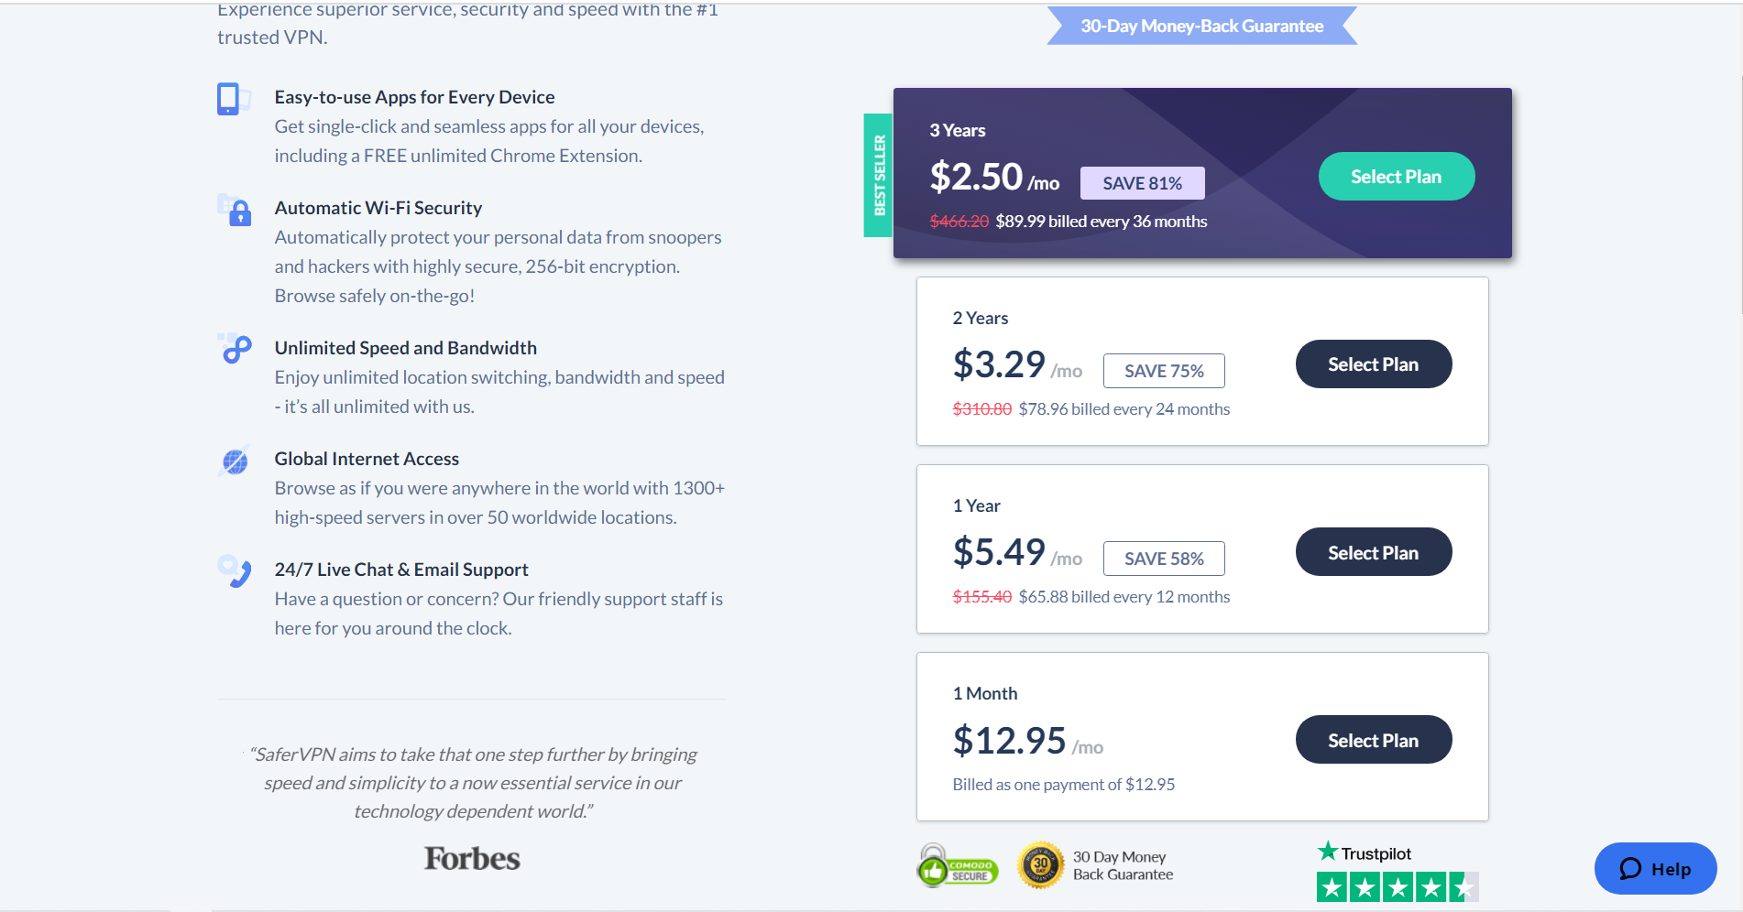
SaferVPN pricing

Slide 12
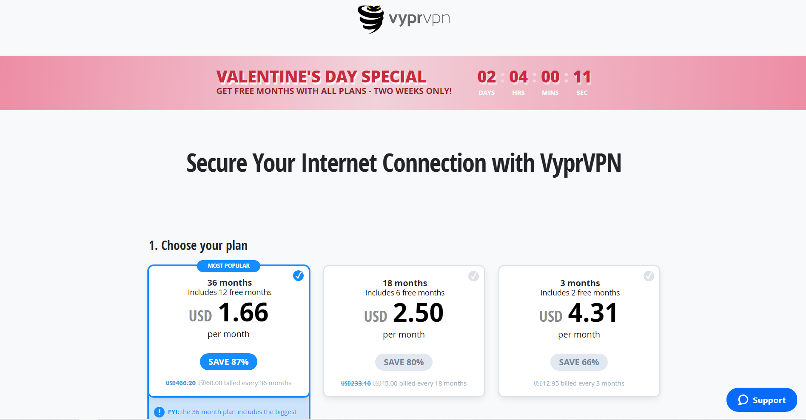
VyprVPN pricing

Slide 13
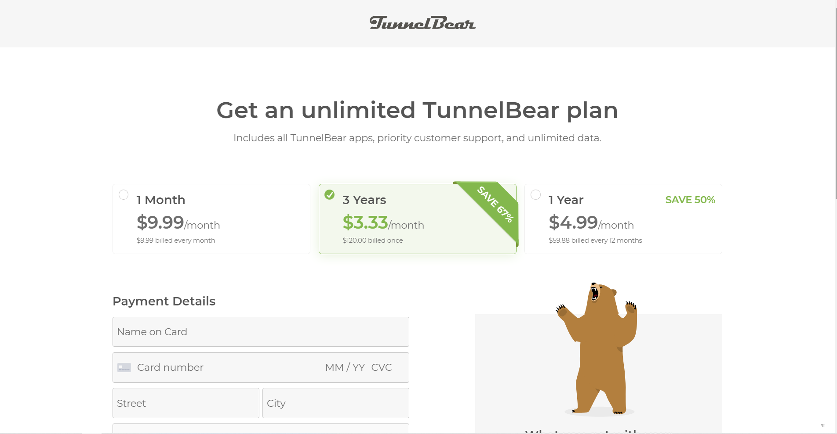
TunnelBear pricing

Slide 14
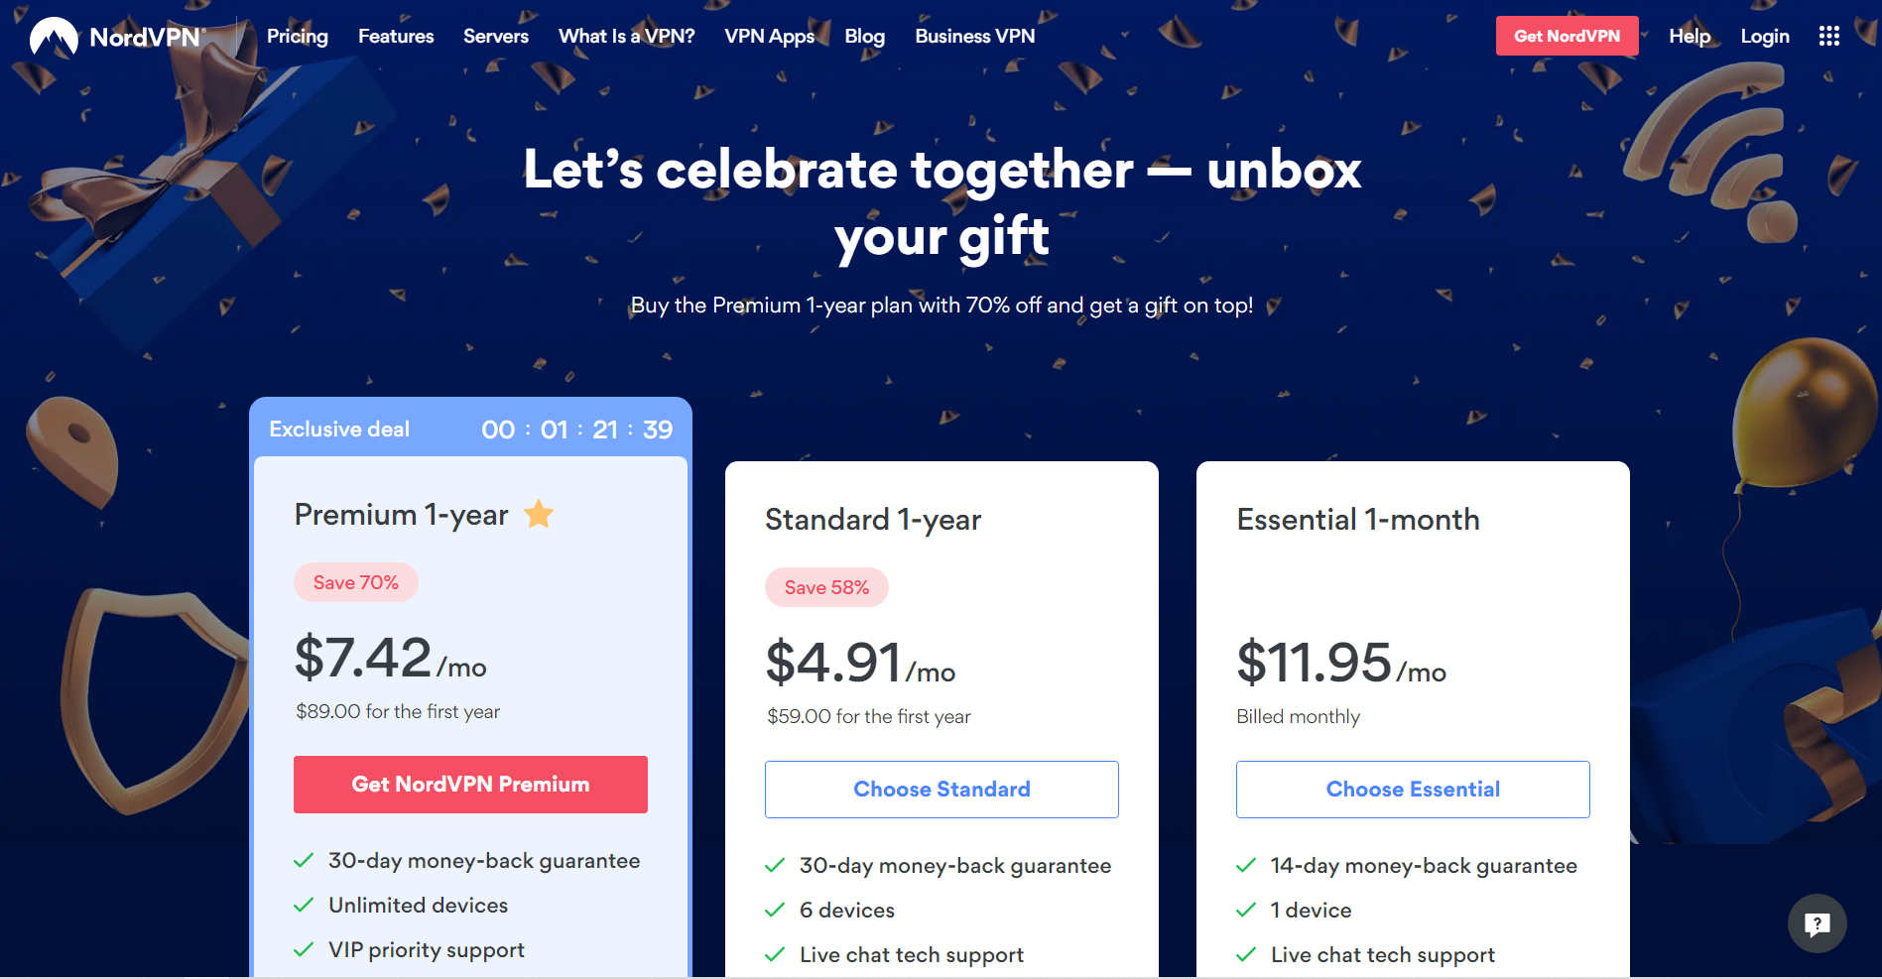
NordVPN pricing

Slide 15
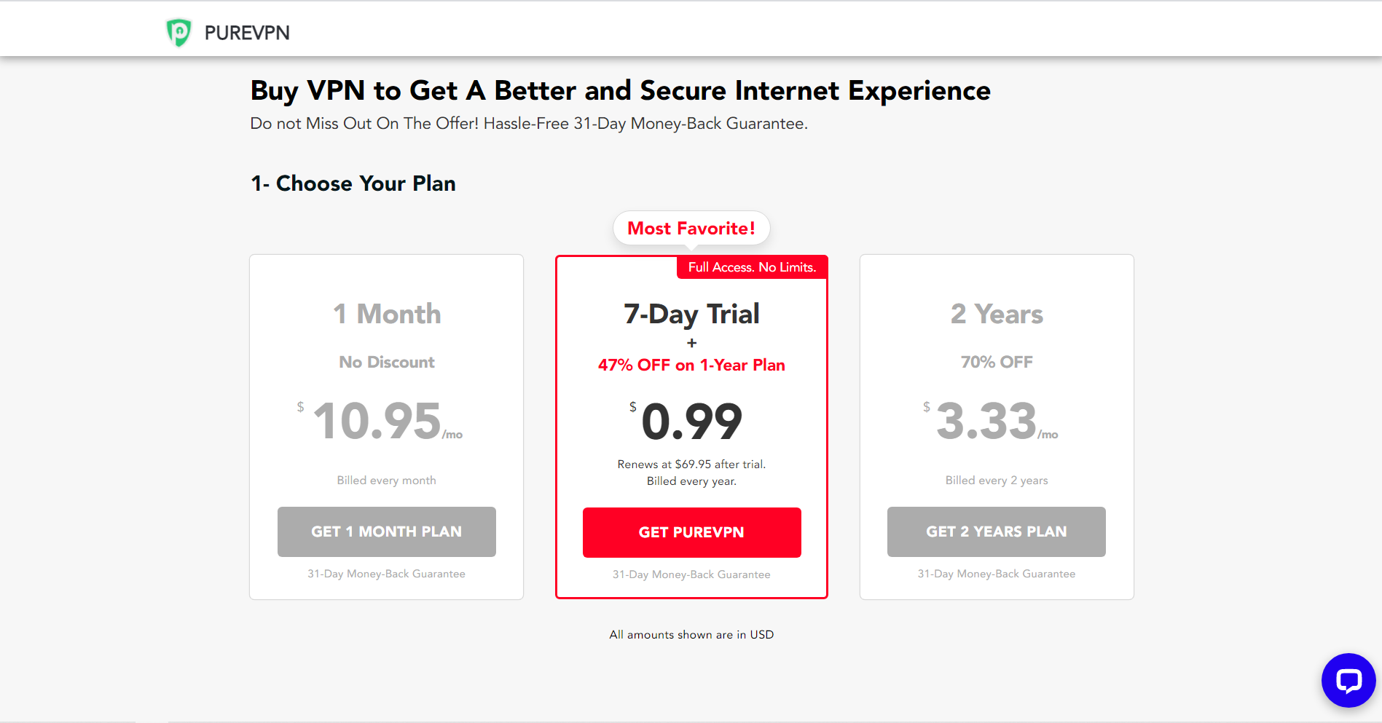
PureVPN pricing

Slide 16
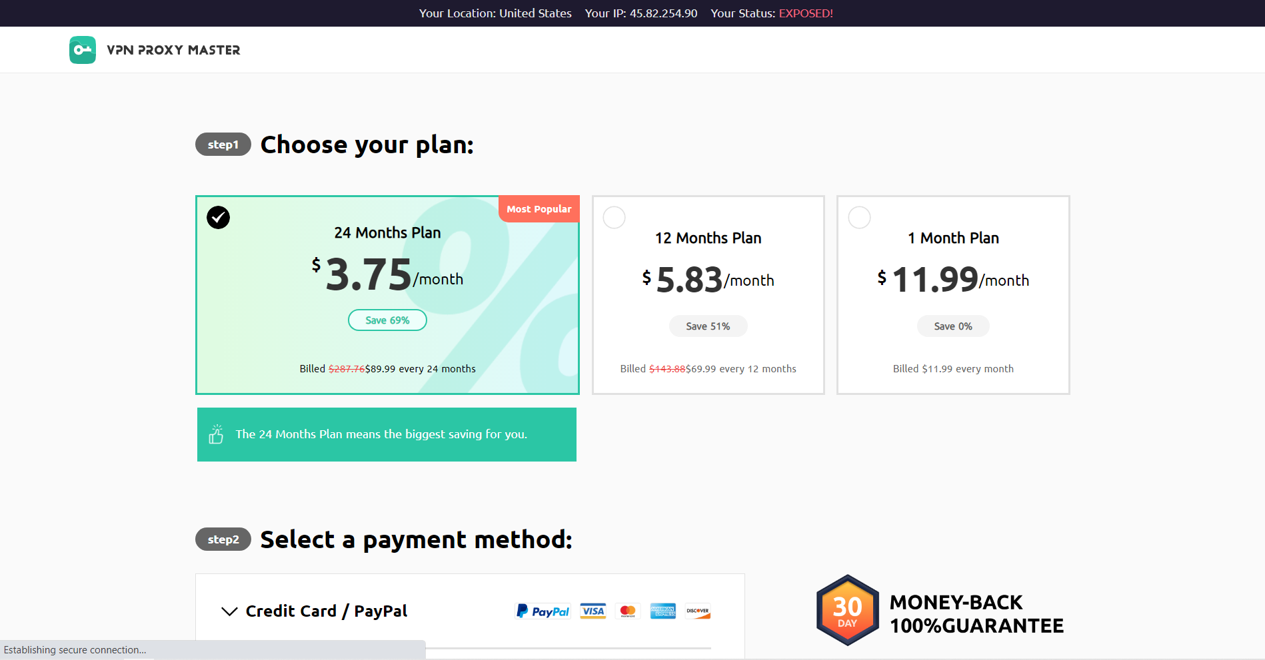
VPN Proxy Master pricing

Slide 17
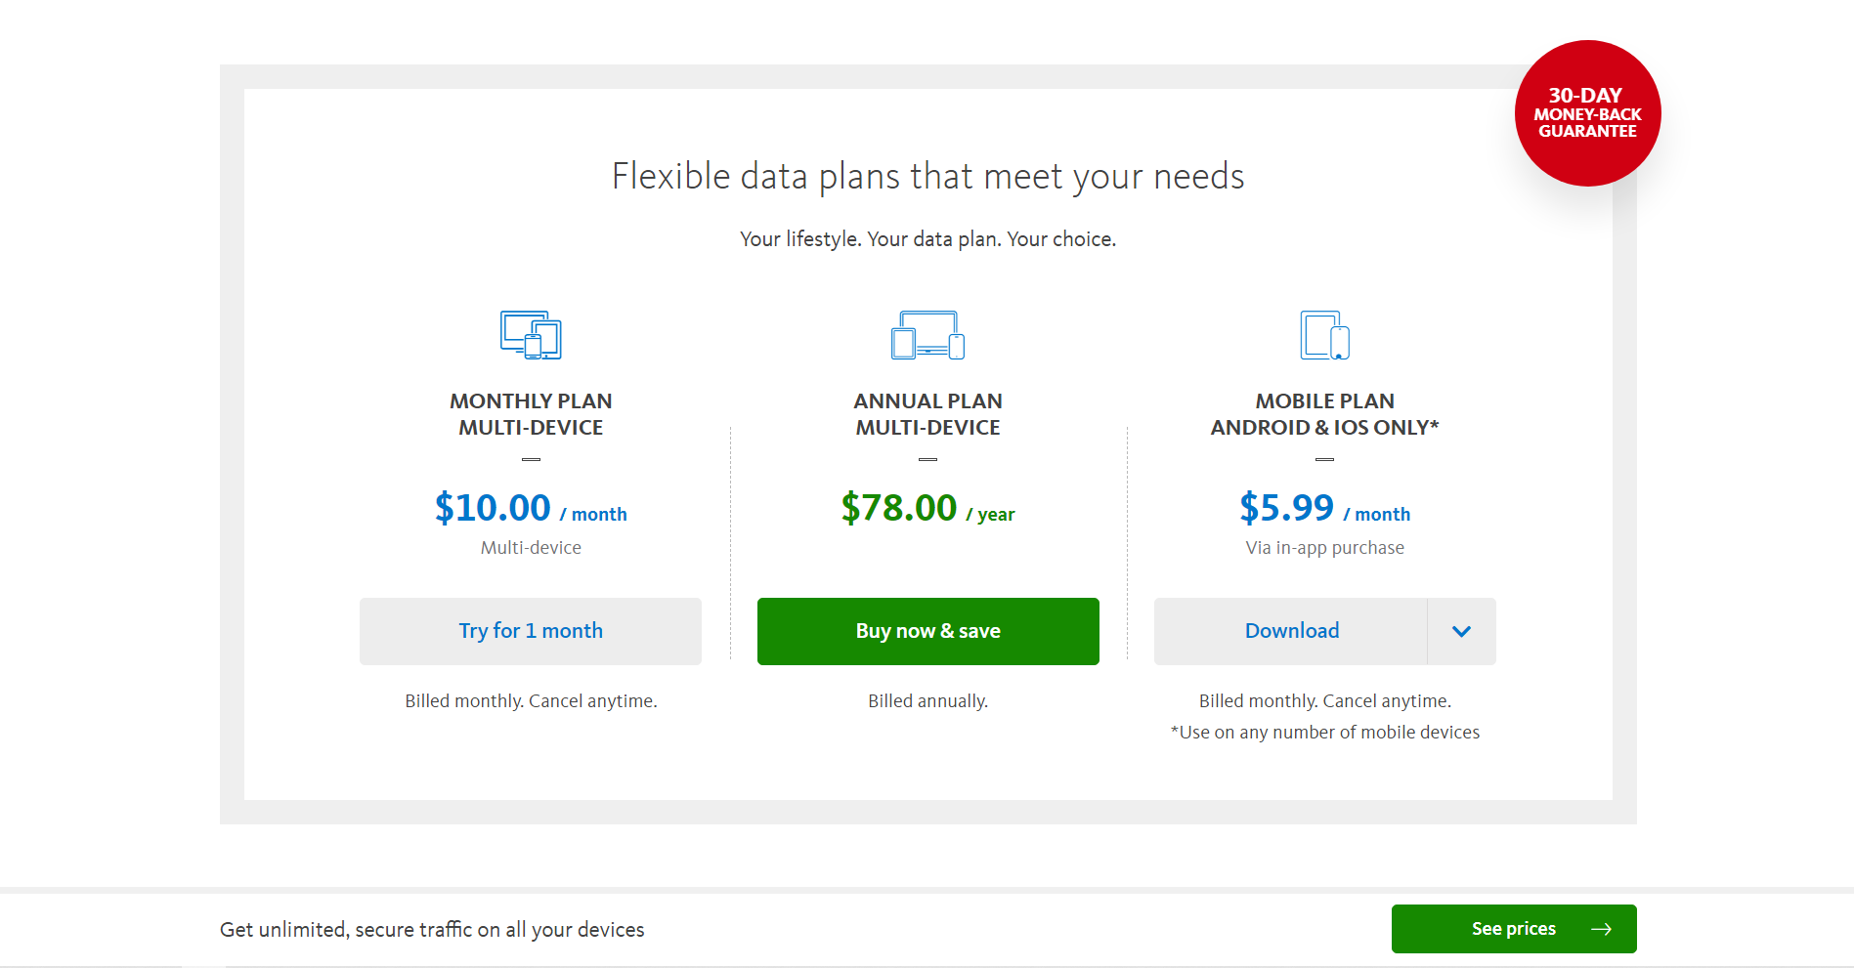
Avira Phantom VPN PRO pricing

Slide 18
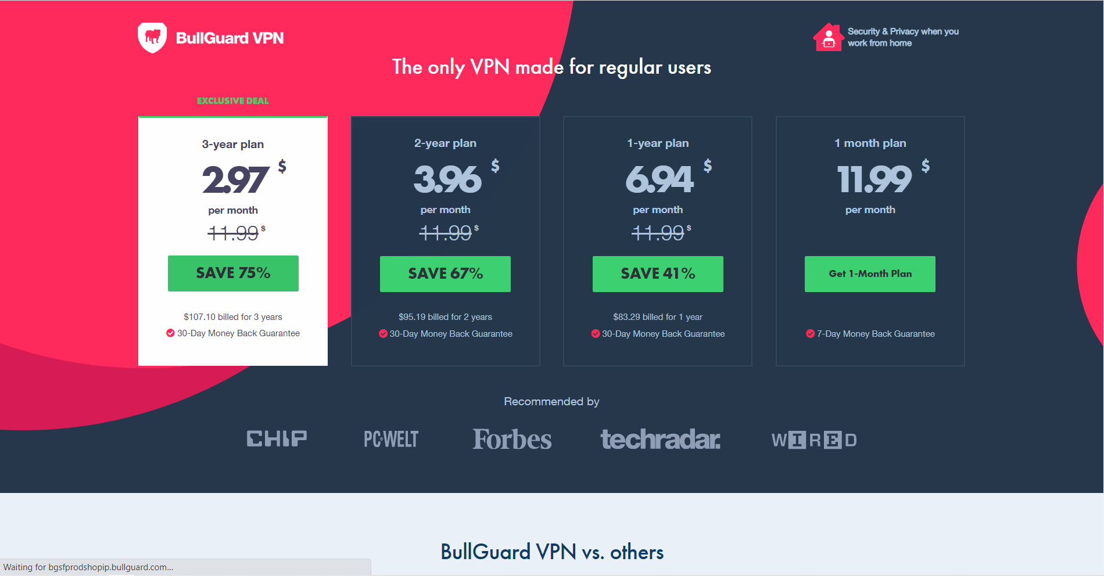
BullGuard VPN pricing

Slide 19
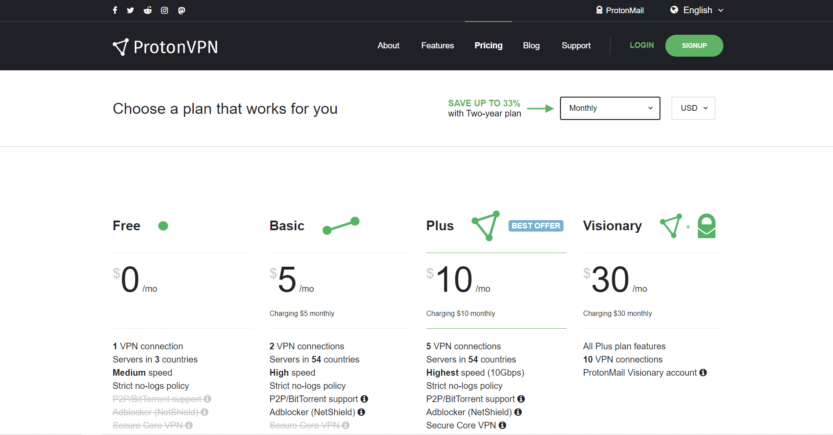
Proton VPN pricing

Slide 20
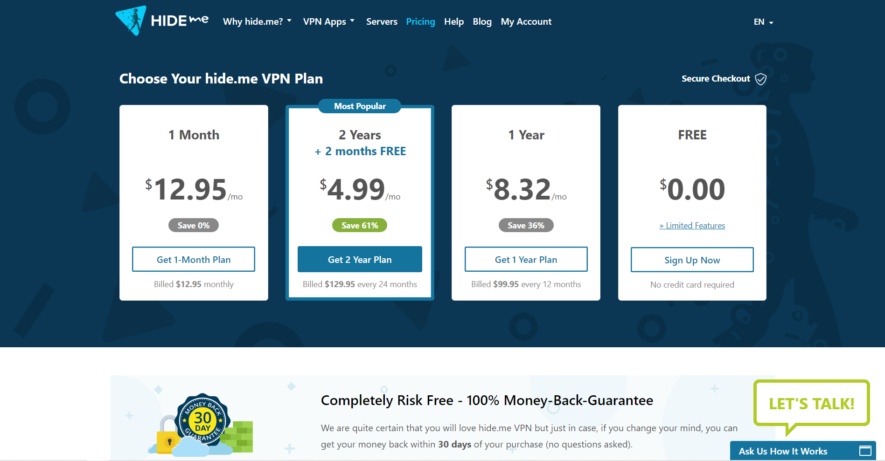
Hide.me pricing

Slide 21
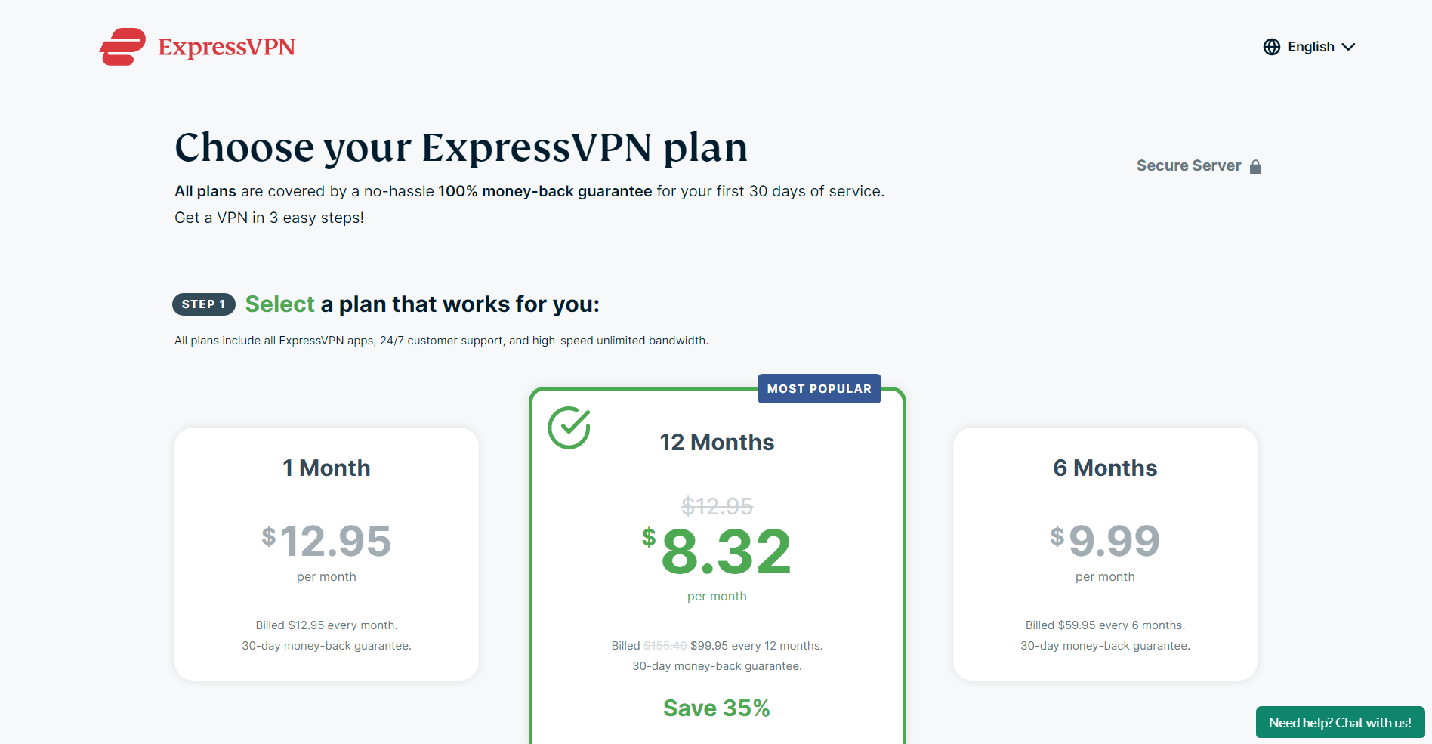
ExpressVPN pricing

Slide 22
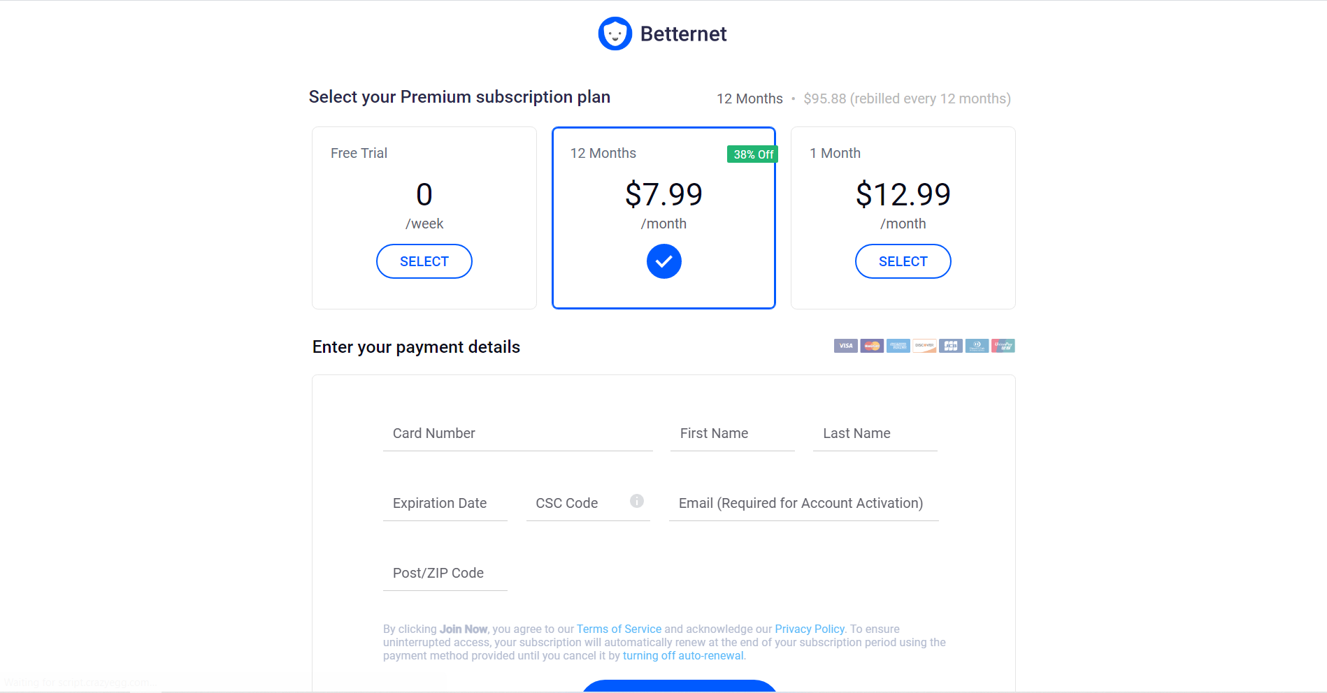
Betternet pricing

Slide 23
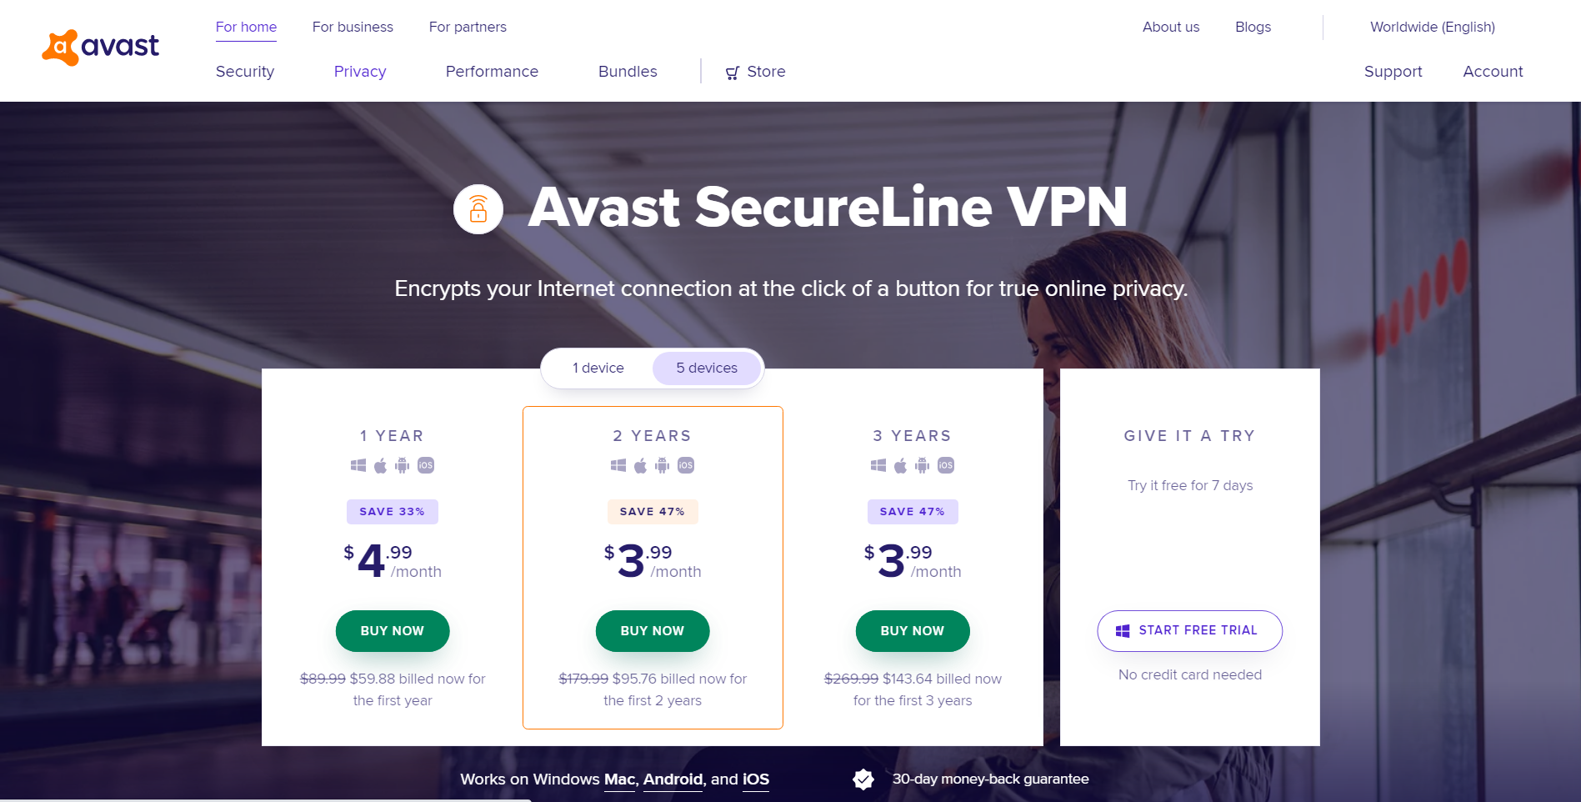
Avast SecureLine VPN pricing

Slide 24
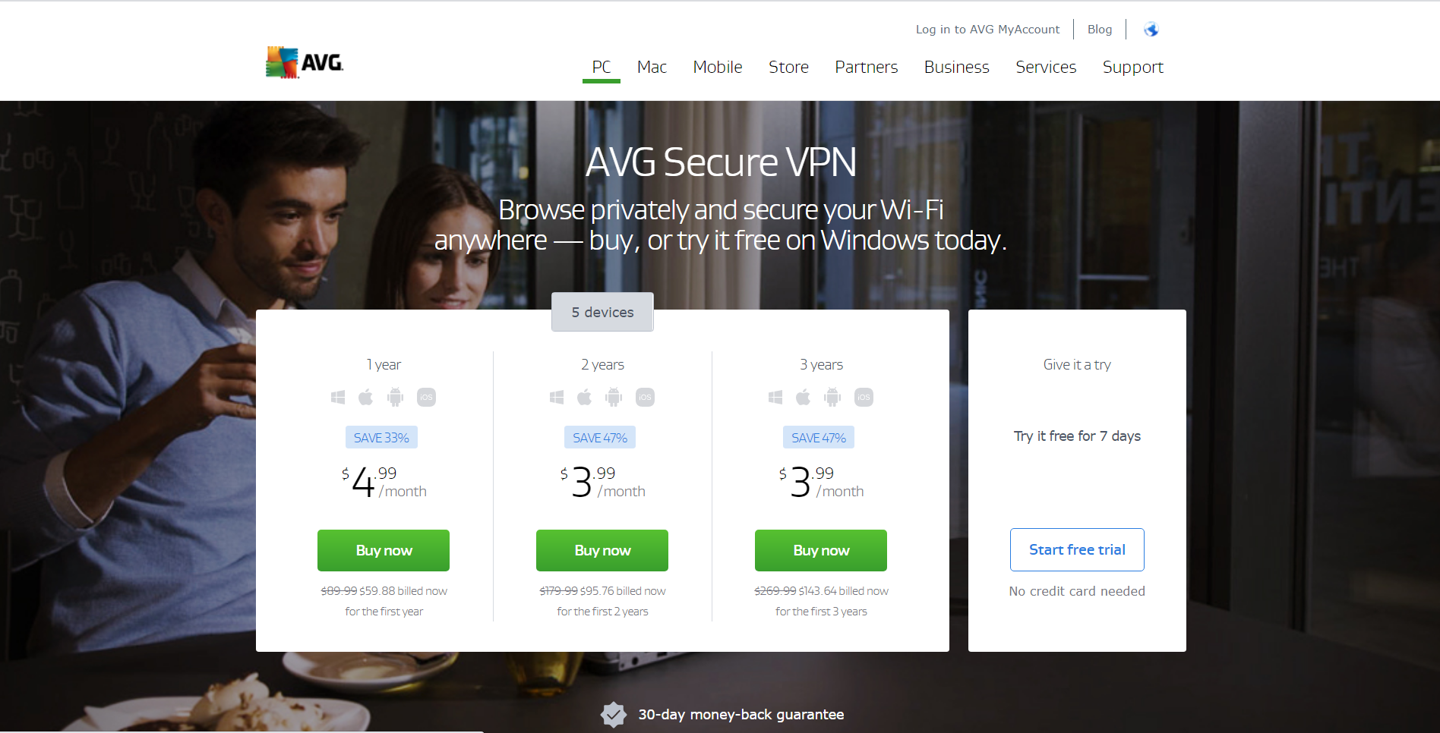
AVG Secure VPN pricing

Slide 25

Best VPN

